Slide 1


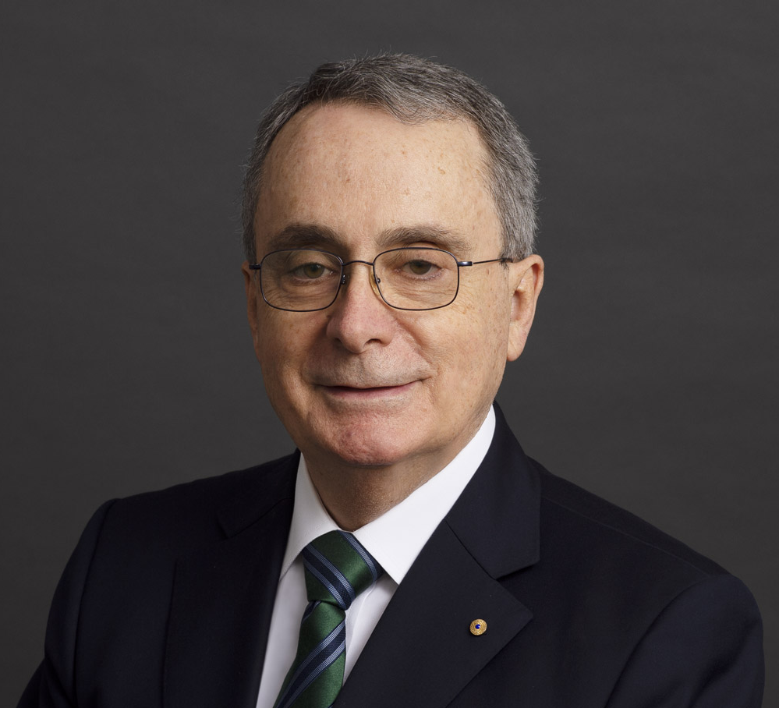
Ciarb Australia Annual Lecture 2025
Diversity of Expertise in Arbitration: The Past, Present and Future
Professor Doug Jones AO 14 October 2025 Holding Redlich, Level 65/25 Martin Place, Sydney

Slide 2

Introduction
Celebrating Ciarb Australia’s Growth & Leadership
Broadening Arbitration Beyond Lawyers

Slide 3

Outline
1.
2.
3.
4.
Past
Present
Future
Conclusion

Slide 4
The Past
My experience
(Many) years ago…

Slide 5
The Present
02

Slide 6
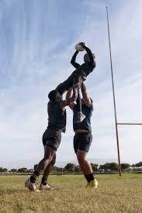


Where There is Not a Problem
Sport
Commodities
Maritime
Notes:
My experience

Slide 7
The Present:
The Issue with Commercial Arbitration
It is a lack of diversity of expertise with lawyers dominating arbitral appointments

Slide 8
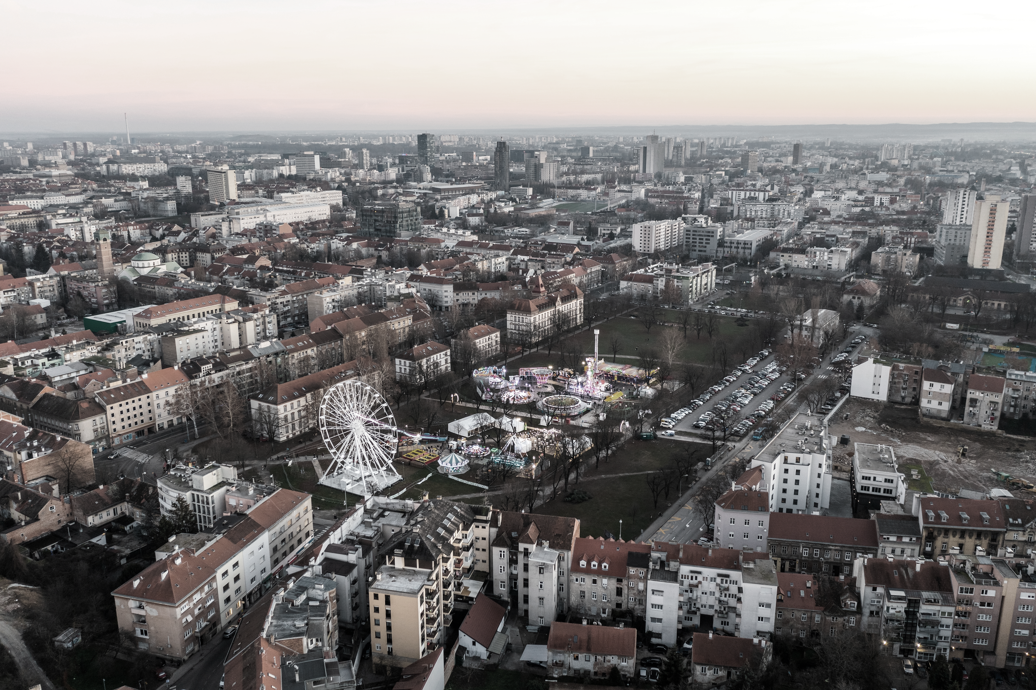
The Future
03

Slide 9
The Future
What Has Been Lost
Loss of expertise diversity – Arbitration has narrowed to legally‑trained arbitrators, overlooking the value of technical and non‑legal specialists who could strengthen tribunals’ ability to engage with complex evidence.
Diminished effectiveness – Without expert arbitrators, tribunals struggle to reconcile competing technical analyses, reducing efficiency, innovation, and the distinctiveness of arbitration compared to court litigation
Retrieving the Position
Barriers to non‑lawyer arbitrators – entrenched party appointment practices, cost pressures, and reliance on legal expertise limit diversity despite no statutory requirement for legal training.
Paths to change – attitude shift supported by Ciarb training, mentoring, tribunal secretary roles, user awareness, and recognition of non‑lawyers’ adjudicative experience (e.g. dispute boards).

Slide 10

Conclusions:
Arbitration’s legitimacy at risk – dominance of lawyers and failure to embrace diverse expertise undermines quality and credibility.
Ciarb and the community must champion solutions that restore diversity of expertise and enhance decision‑making.

Slide 11
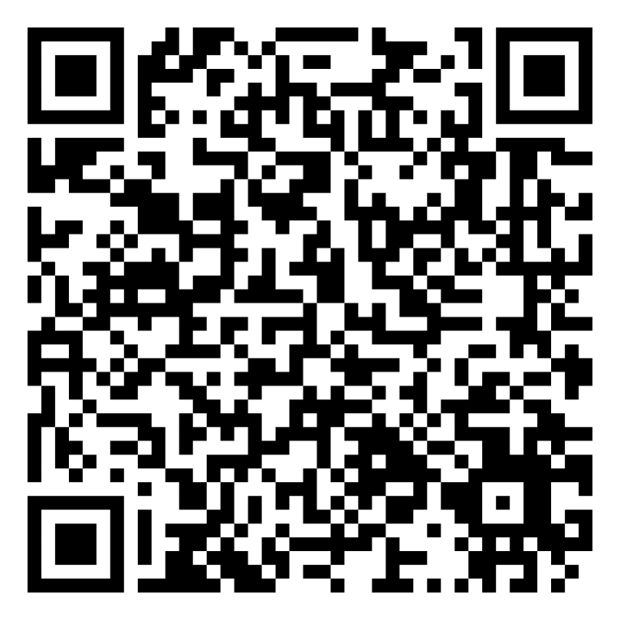
Thank You!
View the full paper via the QR Link:

